Slide 1
3-D MAZE
Mihir Radia

Slide 2

Agenda
Introduction
Current Application
Future Work

Slide 3
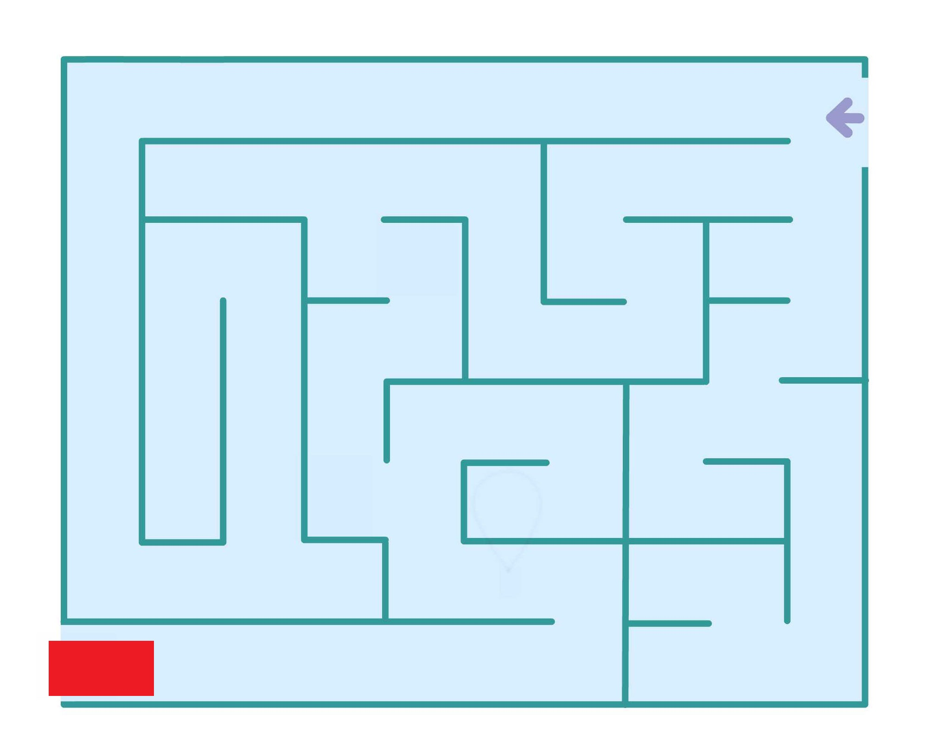

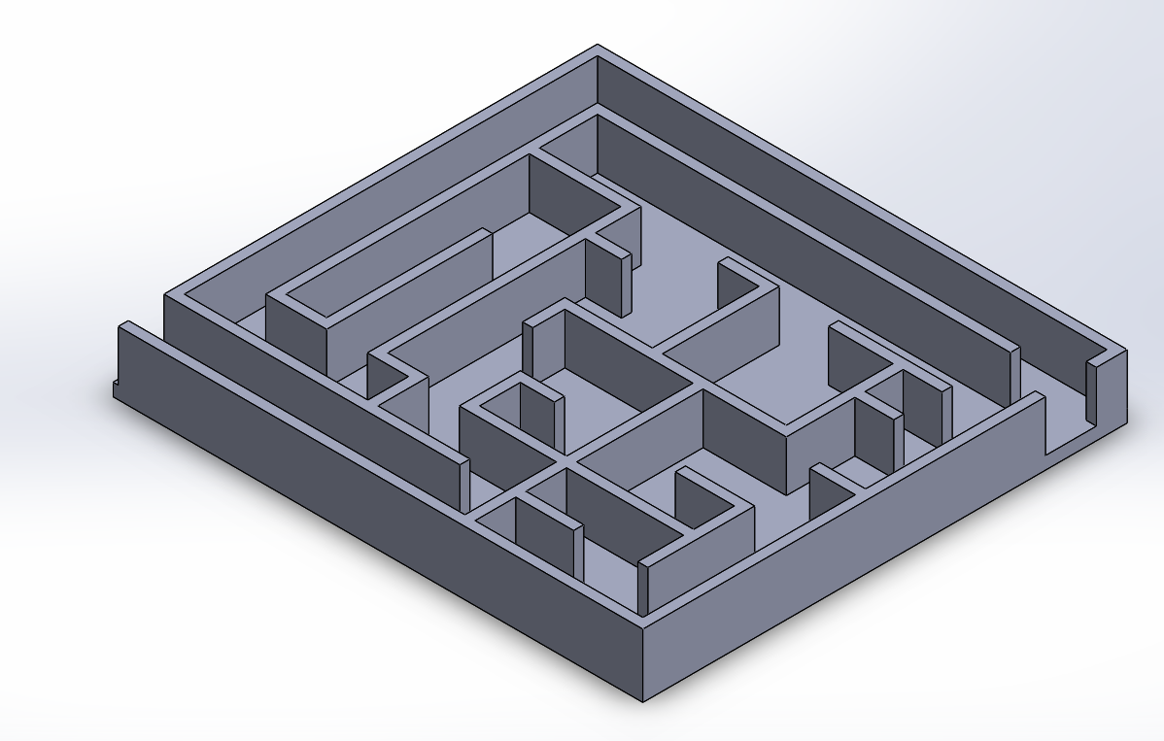
Introduction

Slide 4
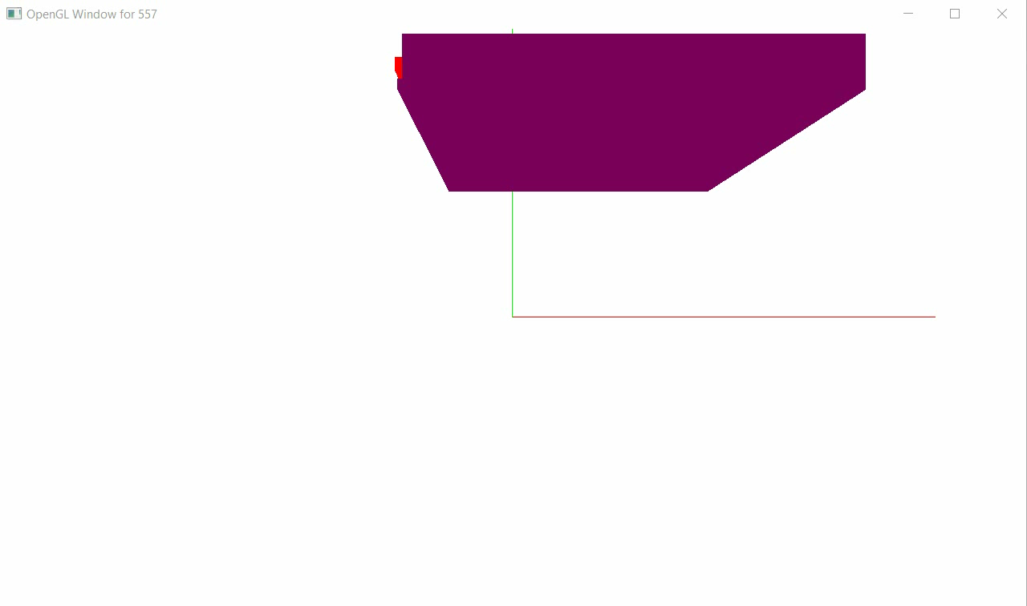
Current Application

Slide 5
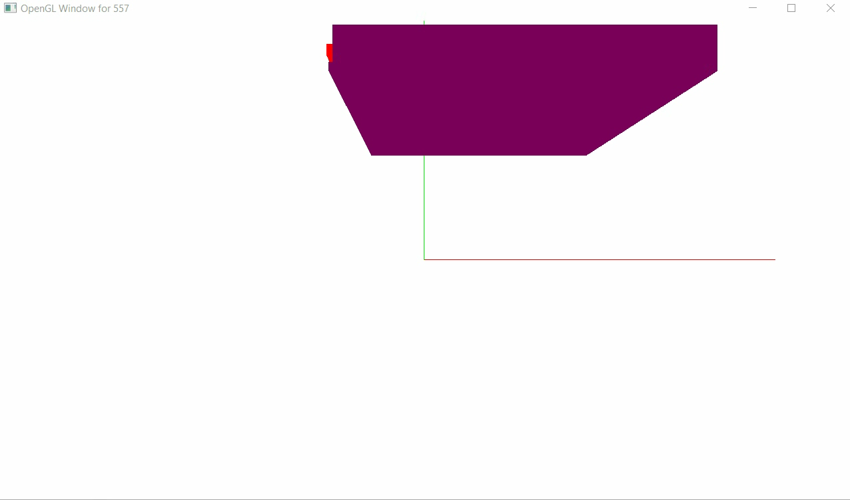
Current Application

Slide 6
Future Work
Texture
Base
Walls
Camera Controls
Animation
Left
Right

Slide 7
Thank You

